Slide 1
Accessing Clever
@ Highlands School District

Slide 2
Clever - What is it?
Clever brings all K-4 applications into one secure portal to provide a single sign-on for everyone in the district.
Many applications/websites have a required login and password for students to access the content. Clever is simply a way to house these frequently used sites and pass through the login credentials to access those sites.

Slide 3
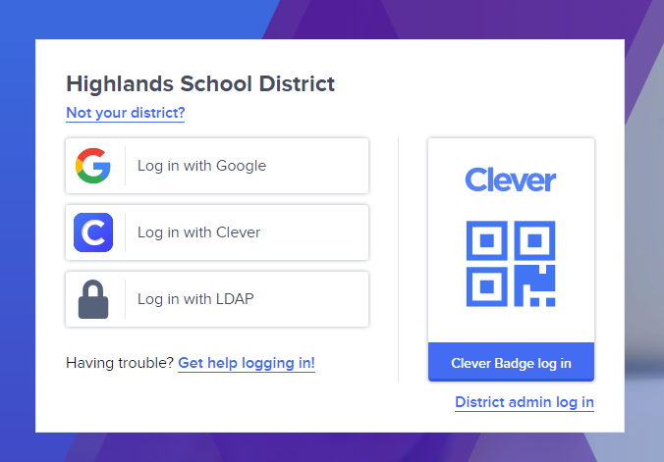
Visit the following site to access the Highlands Clever Portal
https://clever.com/in/goldenrams

Slide 4
QR code login
If you have a QR code, and device with an accessible camera, you can use the Clever Badge login to simply scan your badge and login.

Slide 5
Login with Google
If you do not have a Clever badge, you can login with Google credentials.
Click on the “Log in with Google” link

Slide 6
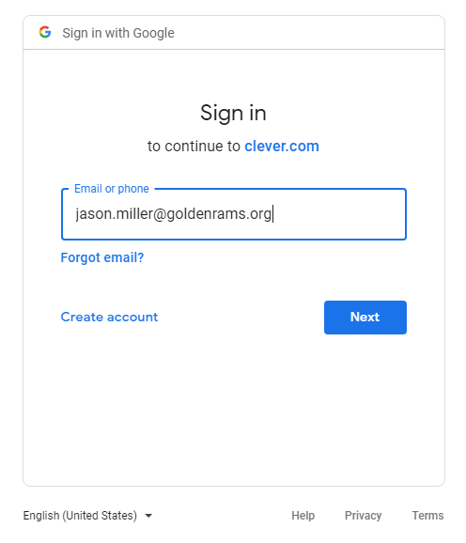
Student Google Credentials
All student’s username and passwords for their Google accounts follow the format: <firstname>.<lastname>@goldenrams.org
Student passwords are their Student ID/Lunch number.
Example: Jason O’Leary
Username: jason.o’leary@goldenrams.org
Password: 234567

